Slide 1

Financial Analysis Sentiment Tool
Danny Boone, John Lattal, Benjamin Weideman, Ilyas Kussanov

Slide 2
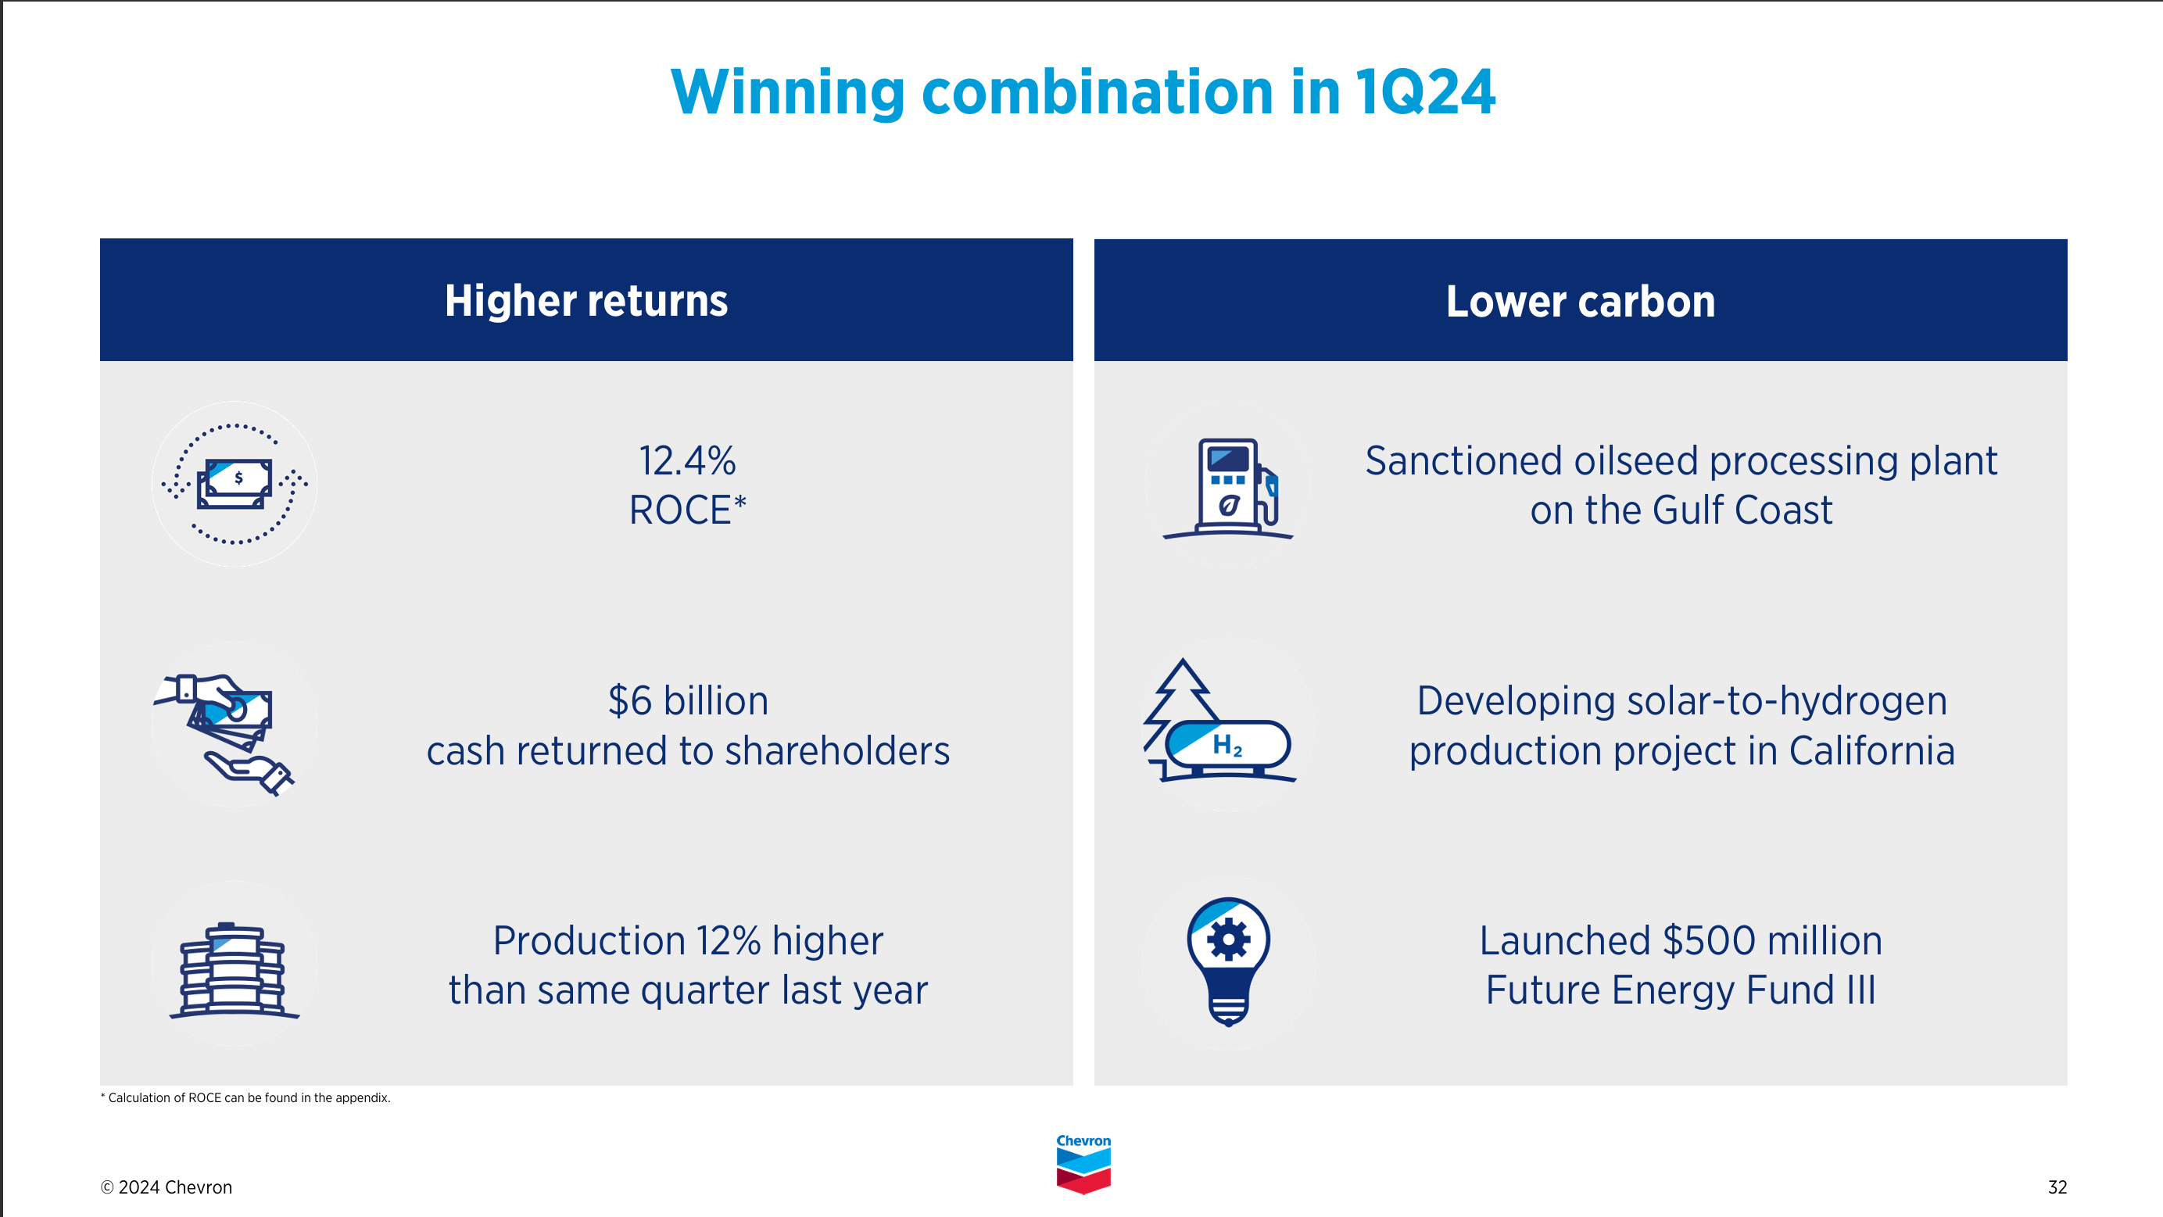
Look Familiar?
Notes:
Slide from Chevron’s April 26, 2024 Investor Presentation

Slide 3







Project Objective
Use sentiment analysis to identify and quantify key factors affecting stock movement in the oil industry.

Slide 4



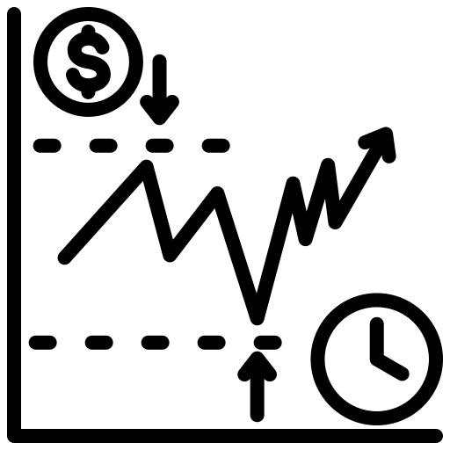


Pipeline Review
1 - Data Scraping
3 - Sentiment Analysis
5 - Vector Database
2 - Data Cleaning
4 - Stock Modeling
6 - RAG

Slide 5
Data Ingestion
1 - Raw Data Sources
2 - Raw Data Types
3 - Text Extraction Packages
4 - Processed/Cleaned Data
Analyst Reports
News Articles
SEC Filings
Earnings Call Transcripts
PDF's
Database URL's
HTML
pdfplumber
BeautifulSoup
selenium webdriver
Saved as .csv
Additional cleaning
Prep for sentiment analysis
Prep for vector database
Notes:
Key Points:
Start of project had a large focus on data ingestion due our team having to compile our own dataset
Process of choosing relevant, reliable, and reputable data sources and assessing how we would need to ingest them based on how/where they were stored and in what format.
Work through the challenges of extracting text from these various data types, utilizing some helpful python packages
Ingest/Pre-process the text, combining, formatting, and saving as .csv files for additional cleaning and model prep
Transition:
After compiling all the data the next slide will share the makeup of our dataset as of now
Challenges:
Web Scraping: Credentials, Cookies acceptance
HTML Tag Identifications
Data Cleaning
Tabular data in PDF’s
Company relevance within news articles
Additional Data Cleaning

Slide 6
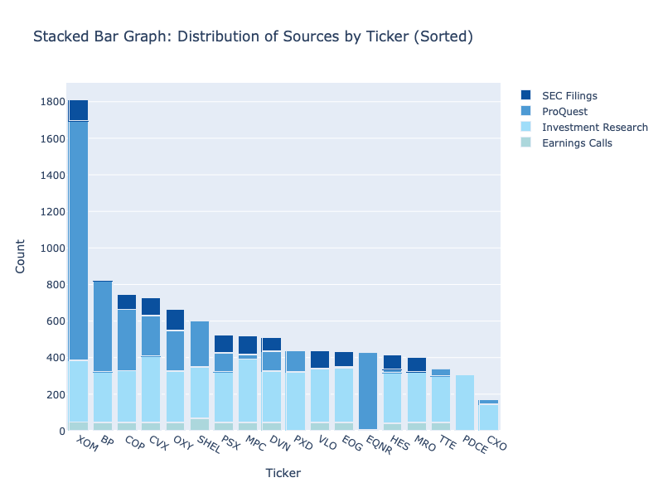

Dataset Sources – Data Exploration
News Articles
3708
Analyst Reports
4896
SEC Filings
1036
Earnings Transcripts
634
5 years of data (2019-Current)
18 companies
10,274 text extracts
Notes:
Key Takeaways:
Chose 18 companies which were deemed comparable for competitive performance vs Chevron
Utilized 5 years of data to create a substantial dataset size while still maintaining historical relevance for sentiment training
4 total sources which totaled just over 10K text extracts (vary in length) : Will this be enough data to obtain accurate results? If we need more should our first course of action be additional companies or a new source?
Transition:
Now that the data has been ingested, cleaned and pre-processed.. We can move on to our next step in the pipeline, Sentiment analysis

Slide 7



Sentiment Analysis with Prompt Engineering (LLAMA)
Example Document Output
• Financial Targets - Achieved Target
• Exploration / Discoveries - N/A
• Reserves – Minor Reserves Add
• Production Targets - Below Target
• Environmental Factors - Positive
Docs
LLM
Tabular Data
Prompt
Simplified Prompt
Task Decription: Analyze the following document and produce a structured summary categorizing the company's performance across multiple predefined categories.
…
Example Output:
Financial Targets – Achieved Target
Production Targets – Below Target
Reserves – N/A
…
Company | Financial Targets | …. | Environmental Factors
Chevron | Achieved Target | … | Positive
… | … | … | …
Actual prompt word count: 524
Notes:
Key Points:
Introduction to Finance Data and LLMs
Now let’s discuss how we use finance data and what we want to retrieve from it using Large Language Models (LLMs).
Document Content and Categories
Each document contains information about multiple oil and gas finance categories that drive the stock price movement of a company.
Based on our domain knowledge and literature review, we identified key categories that we want to analyze using sentiment analysis.
Implementation of Prompt Engineering
To achieve this, we are using prompt engineering to refine the inputs given to a large language model.
This process enables us to effectively obtain the desired output categories and perform sentiment analysis.
Components of Our Prompt Template
Task Description
Query stating what we want from the model.
Ask the model to analyze the text and categorize the company’s performance and related impacts across multiple predefined categories.
Predefined Categories and Sentiment Options
Define categories and provide 3 to 5 sentiment options per category to reflect the sentiment level.
Examples
Feed the model with examples of the desired output to improve accuracy.
Accuracy Assurance Prompts
Limit the model’s creativity in the output format.
Command the model to reread the document text to ensure full understanding.
If unsure, prompt the model to re-evaluate specific sections of the text.
Process Overview
Document text is fed into the local LLM using the prompt template.
The LLM produces the output in a predefined format.
Display a sample from one article showing the model provided the output as queried.
Each news article or financial report is processed one by one through this pipeline.
Data is stored in a tabular format for the next steps.
Transition:
Following this pipeline and using local LLM we faced two main challenges, that I would like to discuss with you.

Slide 8






Challenges
Output Consistency
Output Quality
**Summary**
Summary:
- Financial Targets – “Achieved Target”
LLM x 3
LLM x 3
LLM x 3
**Output Format**: <br> • Use bullet points for each category. <br> • For each category, provide the status or sentiment extracted from the article. If no specific information is available, indicate 'N/A'. <br> **Example Output**: <br>
….
Summary:
• Financial Targets - Achieved Target
• Exploration / Discoveries - N/A
• Reserves - N/A
…..
• Regulatory / Geopolitical Factors - Potential Small Disruption to Operations
• Environmental Factors - N/A
Same output
Notes:
Challenges:
Output Consistency
Consistent output is crucial for transforming data into a tabular format using regular expressions.
State-of-the-art LLMs like GPT and Gemini produce relatively consistent outputs, but smaller local LLMs are much more inconsistent in the output formatting.
The primary reason for using local LLMs is cost, as processing large amounts of text through GPT is expensive.
Output Quality
Quality issues are common in news articles, which often mention multiple companies.
Financial reports typically cover only a single company per document, resulting in fewer quality issues.
For example, an article about Chevron's delay in acquiring Hess due to interference by Exxon mentioned three companies and their performance histories.
Such articles are likely tagged for each company, and the sentiment analysis output should vary accordingly.
Even ChatGPT struggles to differentiate the outputs for each company, sometimes making mistakes such as attributing a major discovery to Chevron when it was actually Hess.
Achieving higher quality output with local LLMs becomes much harder in such cases.

Slide 9
Stock Prediction & Insight Retrieval
Query Prompt
How the sentiment analysis will be used to retrieve insights is what is unique about this work
Ex. What impacted the company's stock price?
Sentiment
Analysis
Stock Prediction
date
sentiment
[•••••••••••••••]
Filter, cosine similarity
Text Chunk 1
Text Chunk 2
Text Chunk 3
Chunked Documents
Vector Database
id, date, sent, [•••••••••••••••]
id, date, sent, [•••••••••••••••]
id, date, sent, [•••••••••••••••]
id, date, sent, [•••••••••••••••]
LLM (ex. Llama 3)
Output
The key topics that impacted stock price:
1) Lower Commodity Prices
2) Impairment Charges
3) Geopolitical Uncertainties

Slide 10
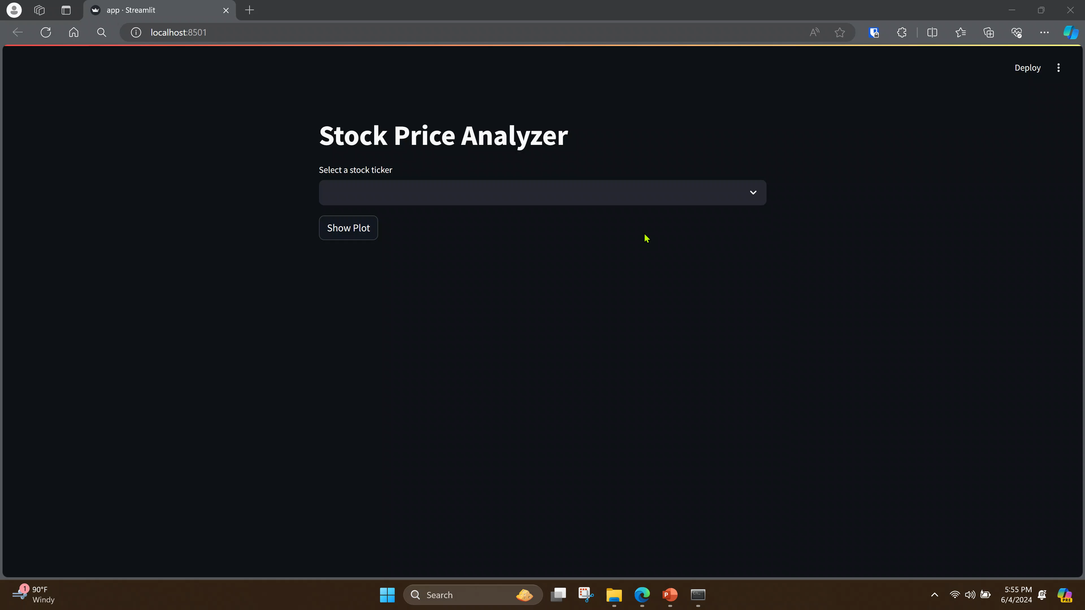
Demo

Slide 11
Recap: Project Objective
Use sentiment analysis to identify and quantify key factors affecting stock movement in the oil industry.

Slide 12





Questions?
1 - Data Scraping
3 - Sentiment Analysis
5 - Vector Database
Analyst Reports
News Articles
SEC Filings
Earnings Call Transcripts
Custom Sentiment Categories
Fine-tuned Local LLM
Validated with ChatGPT / Gemini
Vectorize Text Data
Capture Sentiment as Metadata
2 - Data Cleaning
4 - Stock Modeling
6 - RAG
HTML, PDF, and Text Parsing
Ingest Data into CSV Format
Data Exploration
Predict Stock Movement Based on Sentiment
Determine Feature Importance
Interactive Stock Performance Dashboard
Powered by ChatGPT / Gemini using Retrieval Augmented Generation
Progress

Slide 13
Appendix

Slide 14
Presentation Outline (10-15 minutes)
Introduction - Danny (1 minute)
Background and project objective
Pipeline - Danny (1 minute)
Overview of pipeline which serves as agenda of presentation
Dataset - John (3 min)
Data scraping complete
Data cleaning still in progress
Do we have enough data?
Sentiment Analysis - Ilyas (3.5 min)
Some background on Llama?
Most testing on news articles with poor results. (Example and details about this)
Will continue to test on other data sources after cleaning, expect better results on more focused articles/sources
Risks: Can we actually fine tune a local model? Will prompt engineering get us good enough results?
Stock Prediction and Vector DB - Ben (2 min)
How is this going to improve our results?
Progress to date, using FinBERT as a placeholder to complete our pipeline
Risks: Will we have good enough data quality and quantity to get good predictions?
Demo and Conclusion - Danny (2 min)
Early prototype of our final product, describe vision of one potential use case
Recap what we are trying to achieve
Overall project progress

Slide 15


Problem Statement
Chevron has many performance measures. Which are most critical for our investors?

Slide 16
Pipeline Review
1 - Data Scraping
3 - Sentiment Analysis
5 - Vector Database
Analyst Reports
News Articles
SEC Filings
Earnings Call Transcripts
Custom Sentiment Categories
Fine-tuned Local LLM
Validated with ChatGPT / Gemini
Vectorize Text Data
Capture Sentiment as Metadata
2 - Data Cleaning
4 - Stock Modeling
6 - RAG
HTML, PDF, and Text Parsing
Ingest Data into CSV Format
Data Exploration
Predict Stock Movement Based on Sentiment
Determine Feature Importance
Interactive Stock Performance Dashboard
Powered by ChatGPT / Gemini using Retrieval Augmented Generation

Slide 17
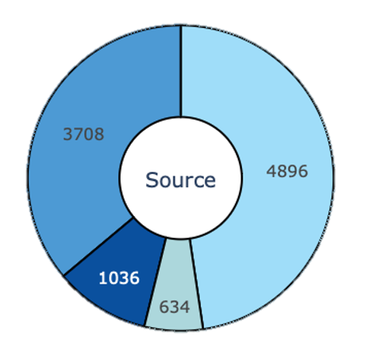
Dataset Sources – Data Exploration
News Articles
Analyst Reports
Primary Sources
Analyst Reports - S&P NetAdvantage
News Articles - ProQuest One Business
SEC Filings - SEC EDGAR database (10K, 10Q, 8K, 11K)
Earnings Call Transcripts - S&P NetAdvantage
Stock History
SEC Filings
Earnings Call Transcripts
Scope/Results
5 years of data (2019-Current)
18 companies
10,000+ text extracts
Notes:
Key Takeaways:
Chose 18 companies which were deemed comparable for competitive performance vs Chevron
Utilized 5 years of data to create a substantial dataset size while still maintaining historical relevance for sentiment training
4 total sources which totaled just over 10K text extracts (vary in length) : Will this be enough data to obtain accurate results? If we need more should our first course of acton be additional companies or a new source?
Transition:
Now that the data has been ingested, pre-proccessed, and cleaned. We can move on to our next step in the pipeline, Sentiment analysis

Slide 18
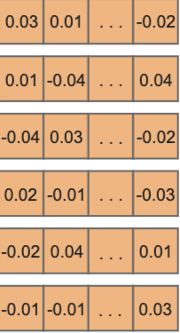
Sentiment Analysis with FinBERT
Encoder
Tokenizer
101
2566
2165
111
102
Embedding Layers
Final Layer Output
Normalization and Residual Connections
[CLS]
Oil
price
drop
[SEP]
Aggregation
Sentence level
Text section
Document level
Transformer model
Feed-Forward
Self-Attention
Classification Head
Token Embedding
+ Position Embedding
+ Normalize output
Prediction
Sentiment: Positive (with a probability of 0.65)
Notes:
I will be walking you through the process of sentiment analysis using a BERT transformer model, illustrated by the pipeline diagram on the slide.
Step 1: Input Text
We start with the input text, which in this case is "oil price drop". This text is bracketed by special tokens [CLS] at the beginning and [SEP] at the end. The [CLS] token is used to aggregate the sequence-level representation, and the [SEP] token marks the end of the sequence.
Step 2: Tokenization
Next, we feed this sentence into BERT's tokenizer. The tokenizer converts each word or element of the sentence into unique IDs. For example, the sentence [CLS] Oil Price Drop [SEP] is tokenized into IDs [101, 2566, 2165, 111, 102]. Each ID corresponds to a specific token in BERT's vocabulary.
Step 3: Embedding Layers
The token IDs are then fed into BERT's embedding layers. This is where the model starts to convert these IDs into dense vector representations that can capture more information. The embedding layers consist of:
Token Embedding: Converts each token ID into a dense vector that represents its meaning.
Positional Embedding: Adds information about the position of each token in the sequence. This is crucial because BERT does not inherently understand the order of tokens.
Normalization: The output of these embeddings is normalized to stabilize and improve the training process.
Step 4: Transformer Model
Now, these embeddings are processed through BERT's transformer model. The transformer has three key components:
Self-Attention: This mechanism allows each token to attend to all other tokens in the sequence, effectively capturing dependencies and relationships between words. This is crucial for understanding context.
Feed-Forward Network: Each token's attention-weighted embedding is passed through a feed-forward neural network to capture more complex patterns and features.
Normalization and Residual Connections: These are applied to ensure stable and efficient training, allowing the model to handle deeper layers more effectively.
Step 5: Final Layer Output
The output of the transformer model consists of contextualized embeddings for each token in the sequence. These embeddings now contain rich, contextual information.
Step 6: Aggregation
To predict the sentiment of the entire sentence, we need to aggregate the information from all tokens. This is typically done by either using the embedding of the special [CLS] token, which summarizes the sequence, or by averaging the embeddings of all tokens.
Step 7: Classification Head
The aggregated embedding is then passed through additional linear layers, known as the classification head. This part of the model is responsible for producing sentiment scores.
Step 8: Prediction
Finally, the sentiment scores are converted into probabilities using a SoftMax function. The class with the highest probability is selected as the final prediction. For instance, the model might predict that the sentiment of "oil price drop" is positive, with a high probability.

Slide 19


Sentiment Analysis with Prompt Engineering (LLAMA)
Decoder
Linear Transformation
SoftMax Activation
Cross-Attention
Input Embedding
Positional Encoding
Output
text
Masked Self Attention
example
Crafted prompt
Validation with GPT/Gemini
Task description: Analyze the following text and categorize the company’s performance …
**Summary**:
Financial Targets - Achieved Target
Exploration / Discoveries - N/A
Reserves - N/A •
Production Targets - Achieved Target
New Energy Investments / Projects - N/A Acquisitions and Mergers - N/A
Divestments - N/A
Public Sentiment - N/A
Regulatory / Geopolitical Factors - Potential Small
Example 1: Company – Chevron
Financial Target: achieved
Reserves: N/A
Production Targets: Exceeded
Example 2: ….
Notes:
Discussed previously model has its own limitation such as maximum token size, which is 512. That results in difficulties in reaching our desired goal to categorize articles into categories with sentiment analysis.
Following method leverages the power of LLAMA generative capabilities to produce human like responses for sentiment analysis. This approach enable us to feed full article and retrieve summary and categorized sentiments.
Step 1: Input Text and Prompt
We start with the input text, with article text as an example
Alongside, we craft a specific prompt to guide the model's response. The prompt is designed to instruct the model on how to analyze the text and categorize sentiments across multiple predefined categories.
Step 2: Input Embedding
The input text and prompt are tokenized into smaller units, or tokens. Each token is then converted into a dense vector representation through the embedding layer.
These embeddings capture the semantic meaning of each token.
Step 3: Positional Encoding
Positional encodings are added to the token embeddings to provide information about the order of tokens.
This helps the model understand the sequence in which the tokens appear.
Step 4: Cross-Attention and Masked Self-Attention
Masked Self-Attention: This mechanism helps the model focus on relevant parts of the input while generating each token.
Cross-Attention: this allows the model to incorporate context from the prompt into its generation process.
Step 5: Linear Transformation
The decoder’s output is passed through a linear layer, converting the high-dimensional vectors into logits corresponding to the vocabulary size.
Step 6: SoftMax Activation
The logits are passed through a SoftMax function to produce probabilities for each token in the vocabulary.
This step determines the likelihood of each token being the next in the sequence.
Step 7: Output
The model generates a detailed and contextually relevant response based on the input text and prompt.
Example Response:
Validation: After generating the output, we validate the results using models like GPT/Gemini to ensure accuracy and consistency in the sentiment analysis.
Feedback:
Possibly break out crafted promt to another slide
Input/ output slides
Simplifly decoder to just one box?
Update summary to something that has answers and not just N/A
Black on blue

Slide 20
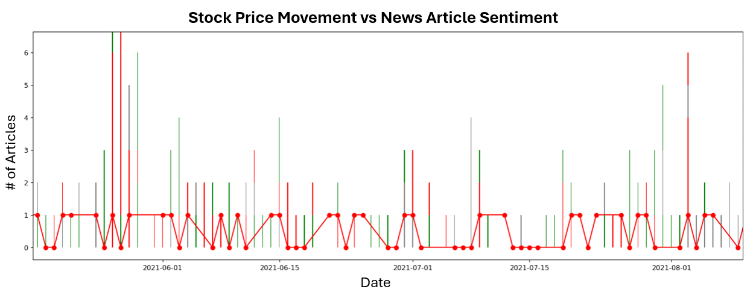
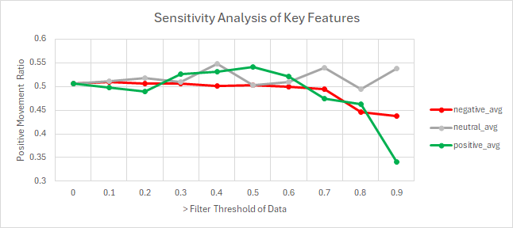
Stock Prediction
Features: Sentiment analysis neutral, positive, and negative scorings and article counts
Target: YahooFinance stock price daily movements {up:1, down:0}
Model: Random Forest Classifier, 62% Accuracy
Key Takeaways:
Neutral and Positive Articles higher probability of price upward movement
Negative Articles higher probability of price downward movement

Slide 21
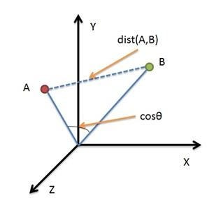
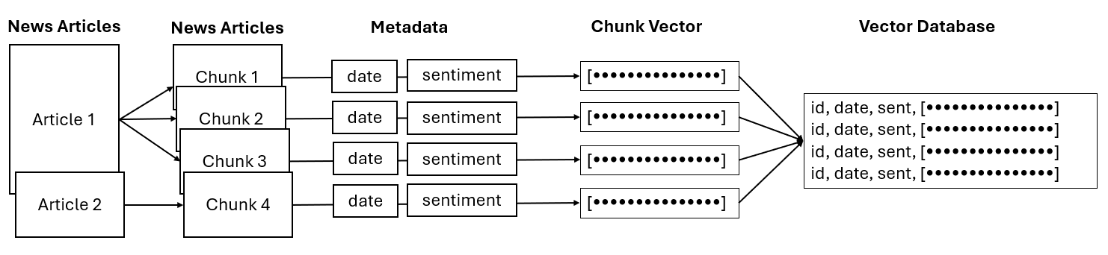
Vector Database
Cosine Similiarity
Retrieval Augmented Generation (RAG)
Provide up to date references without training
Reduce LLM hallucination
Provide direct source referencing
Generate more accurate responses
Vector Database Construction

